Slide 1
Diabetic retinopathy
Ricardo Cepeda

Slide 2
INTRODUCTION
Million of people suffer from diabetic retinopathy.
the leading cause of blindness among working aged adults.
Diabetic retinopathy is a diabetes complication that affects eyes.

Slide 3

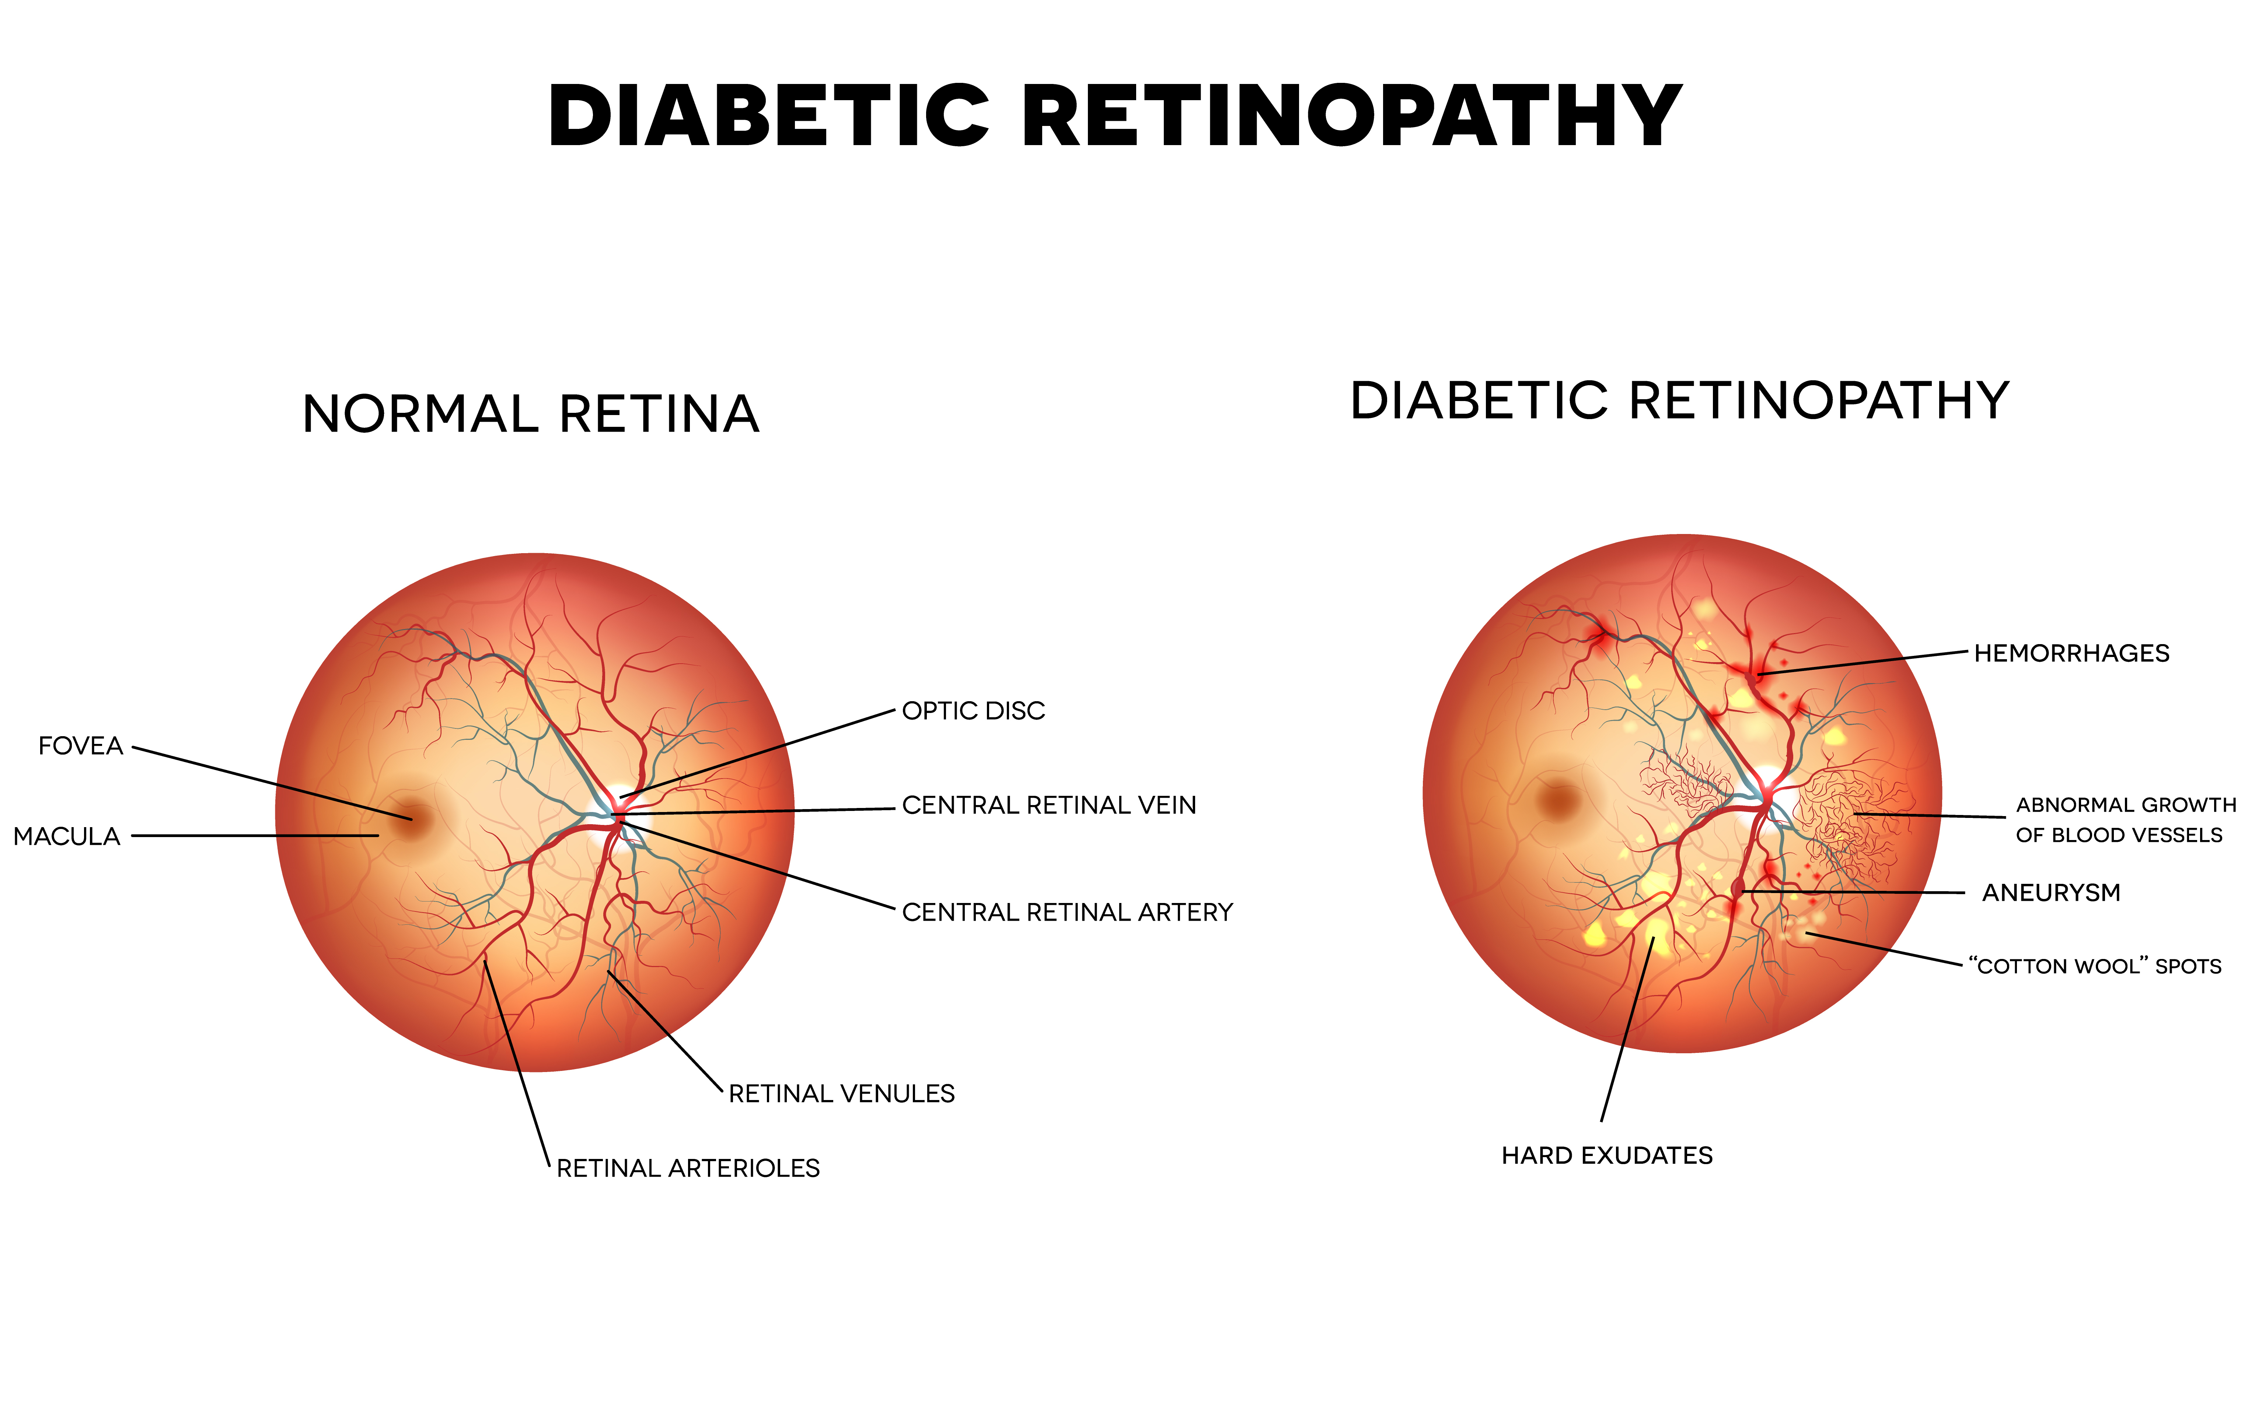

Slide 4
PRIMARY GOALS
To build a machine learning model to speed up disease detection.
Notes:
Criteria for success
The model with the greatest accuracy score on the test set shall be used.
Scope of Solution Space
The model will be applied on the train and test set of images.
Constraints
The capacity of my personal computer for training.
Stakeholders
Public
Data Sources
Data acquired from Kaggle

Slide 5
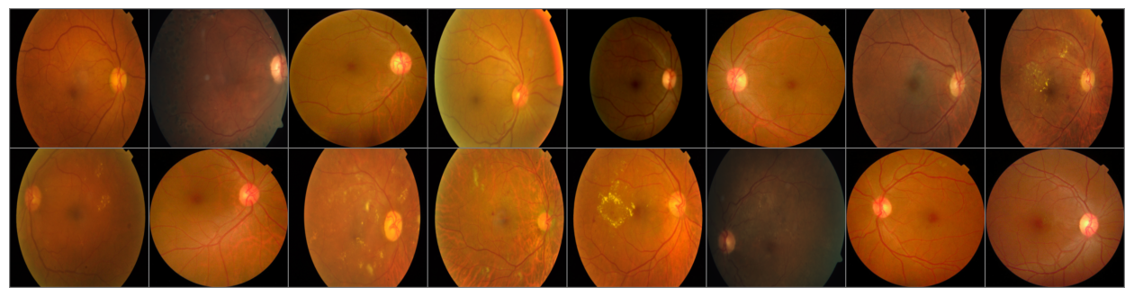
Batch of images

Slide 6
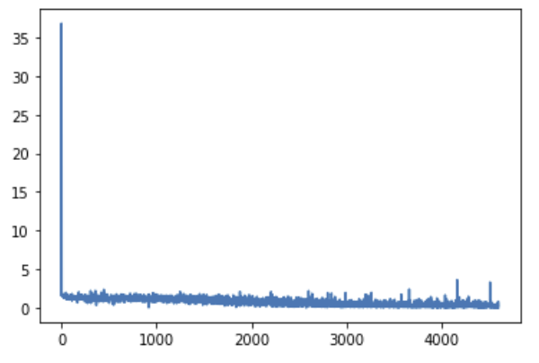
Train loss
Notes:
The model has been trained for 25 EPOCHS. It took hours.

Slide 7
Model performance
Ground Truth | Prediction
Mild | Mild
Proliferative_DR | Moderate
No_DR | No_DR
Mild | Mild
No_DR | No_DR
Mild | No_DR

Slide 8
General accuracy on test set
Severity | Accuracy
Accuracy for class No_DR: | 81.8 %
Accuracy for class Mild : | 70.4 %
Accuracy for class Moderate: | 33.5 %
Accuracy for class Severe: | 12.8 %
Accuracy for class Proliferative_DR: | 28.6 %

Slide 9
SUMMARY
On average we get an accuracy of 69.0 %. This can be the result of many constraints. First, training on a average laptop takes a long time. I tried uploading all the eye images to a cloud service, but I could not get it done due to every time the connection was lost and I had to reupload the images. The cloud service that I used is PaperSpace which is recommended by Springboard. Secondly, The number of images I think was not enough for training. I think the model would have done better if there were more images for the 'moderate', 'severe', and 'proliferative DR' classes. For further work, I recommend using a different cloud service for storage and to get more images.

Slide 10
THANK YOU

